Slide 1

"Predictive Modelling and Analysis of Airfare trends & Ticket
Pricing "
This Photo by Unknown Author is licensed under CC BY-NC

Slide 2
Why Machine Learning Model
🌐✈️ Traveling on a Budget? Unlock the Power of Machine Learning! 🚀
Ever wondered how to predict flight ticket prices and find the best deals? With the help of Machine Learning, you can! By analyzing the records from given dataset, I 've built a powerful Random Forest Regressor model that empowers savvy travelers to make informed decisions and snag the ultimate deals! 🎫✨
Say goodbye to overpriced flights and hello to smart travel planning. Dive into the world of data science and discover how predictive modeling can revolutionize your travel experience!

Slide 3
Problem Statement
The aviation industry in India is witnessing rapid growth, with multiple airlines operating flights across various cities. However, the prices of air tickets are highly dynamic, influenced by a multitude of factors such as demand, timing, airline reputation, and more. For both airlines and passengers, predicting these prices with accuracy is crucial for maximizing revenue and ensuring affordability.
This project aims to develop a robust machine learning model that accurately predicts the air ticket prices for flights within India. By analyzing data from different airlines and flights between various cities, the model will identify key factors affecting ticket pricing and provide insights to enhance decision-making processes for stakeholders.

Slide 4
Data Dictionary
Airline- The name of the airline company
Date_of_Journey- The date on which the journey happened
Source- The city of the departure of the flight
Destination- The destination city/airport
Route- The route of the flight from where to where
Dep_Time- The departure time of the flight
Arrival Time- The time of the arrival of the flight to the destination
Duration- The duration of the flight
Total Stops- Total number of stops during the journey
Additional Info- Extra/Additional information regarding flight/travel
Price- The price of the ticket for a single journey

Slide 5
Data Structure
Airline | Date_of_Journey | Source | Destination | Route | Dep_Time | Arrival_Time | Duration | Total_Stops | Additional_Info | Price
IndiGo | 24-03-2019 | Banglore | New Delhi | BLR ? DEL | 22:20 | 22-03-2024 01:10 | 2h 50m | non-stop | Null | 3897
Air India | 01-05-2019 | Kolkata | Banglore | CCU ? IXR ? BBI ? BLR | 05:50 | 13:15 | 7h 25m | 2 stops | Null | 7662
Jet Airways | 09-06-2019 | Delhi | Cochin | DEL ? LKO ? BOM ? COK | 09:25 | 10-06-2024 04:25 | 19h | 2 stops | Null | 13882
IndiGo | 12-05-2019 | Kolkata | Banglore | CCU ? NAG ? BLR | 18:05 | 23:30 | 5h 25m | 1 stop | Null | 6218
IndiGo | 01-03-2019 | Banglore | New Delhi | BLR ? NAG ? DEL | 16:50 | 21:35 | 4h 45m | 1 stop | Null | 13302
SpiceJet | 24-06-2019 | Kolkata | Banglore | CCU ? BLR | 09:00 | 11:25 | 2h 25m | non-stop | Null | 3873
Jet Airways | 12-03-2019 | Banglore | New Delhi | BLR ? BOM ? DEL | 18:55 | 13-03-2024 10:25 | 15h 30m | 1 stop | In-flight meal not included | 11087
Jet Airways | 01-03-2019 | Banglore | New Delhi | BLR ? BOM ? DEL | 08:00 | 02-03-2024 05:05 | 21h 5m | 1 stop | Null | 22270
Jet Airways | 12-03-2019 | Banglore | New Delhi | BLR ? BOM ? DEL | 08:55 | 13-03-2024 10:25 | 25h 30m | 1 stop | In-flight meal not included | 11087
Multiple carriers | 27-05-2019 | Delhi | Cochin | DEL ? BOM ? COK | 11:25 | 19:15 | 7h 50m | 1 stop | Null | 8625
Air India | 01-06-2019 | Delhi | Cochin | DEL ? BLR ? COK | 09:45 | 23:00 | 13h 15m | 1 stop | Null | 8907

Slide 6
Lifecycle of a Data Science project
Exploratory Data Analysis (EDA): The initial phase where data is explored to understand patterns, relationships, and insights. It involves visualizations, summary statistics, and identifying anomalies.
Feature Engineering: The process of creating new features or modifying existing ones to improve the model's performance. This step involves transforming raw data into a format that better represents the underlying problem.
Feature Selection: The stage where the most relevant features are chosen for the model. This helps in reducing complexity, enhancing model efficiency, and avoiding overfitting.
Model Deployment: Implementing the final model into a production environment for real-world application.

Slide 7
1. Exploratory Data Analysis (EDA):
Importing Libraries and Loading the Data
To start with the task of predicting flight fares using machine learning, we’ll begin by importing the essential libraries required for data manipulation, visualization, and modeling, such as Pandas, NumPy, Matplotlib, and Scikit-learn.
Once the libraries are in place, we'll import the training dataset, which contains historical flight fare dataset, packed with crucial details like airline, source, destination, journey date, total stops, and ticket prices.“

Slide 8
In Data Analysis We will try to Find out
Data Description
To find Null values
Categorical Variables
Outliers
Duplicate Values
Relationship between an independent and dependent feature(price)

Slide 9
2. Feature Engineering: Preparing for Takeoff
"Just like smooth travel requires preparation, we extract journey date and month, manage total stops, and convert flight duration into minutes. We also streamline categorical data using Label Encoder for optimal performance.“
We observe that we have all the columns as ‘object’ data types, and only ‘Price’ column is of integer type. One can find many ways to handle categorical data. Some of them categorical data are,
Nominal data→ data are not in any order → OneHotEncoder is used in this case
Ordinal data → data are in order → LabelEncoder is used in this case.

Slide 10
Exploratory Data Analysis (EDA): Unveiling Hidden Insights
1.Plotting graphs related to price
Price vs Source
Price vs Destination
Price vs Airline plot
2.Plotting graph for journey day and Price
3.Plotting Bar chart for Months (Duration) vs Number of Flights
4.Plotting Bar chart for Types of Airline vs Number of Flights

Slide 11
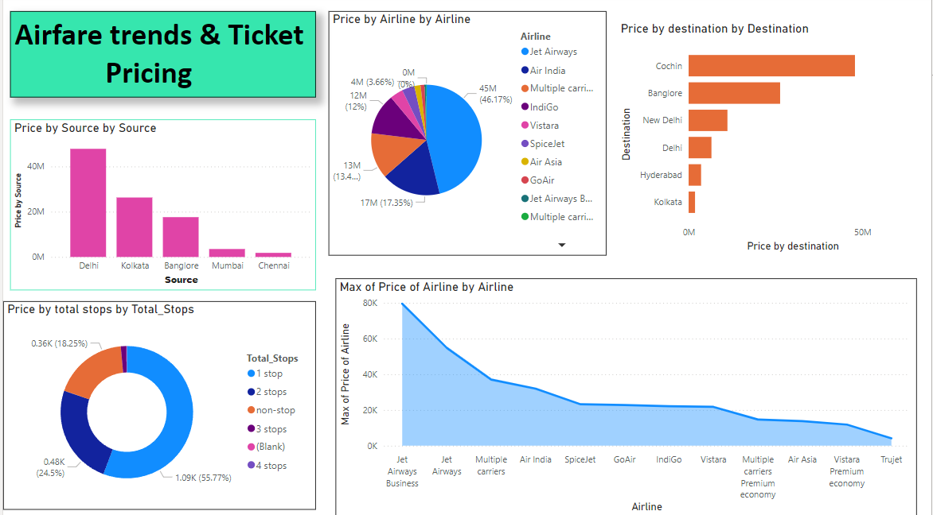

Slide 12
3.Building the Prediction Model Smart Skies
Model Training:
We do not know beforehand which model will perform best on this problem, as it is unknowable. you can try any number of regression models and choose one among them which is best suitable.
we drop the “price” column from train dataset and make (y)independent variable to find correlation between dependent and independent data. After cleaning the data, we can visualize data and better understand the relationships between different variables. There are many more visualizations that you can do to learn more about your dataset, like scatterplots, histograms, boxplots, etc .
Random Forest Regressor model serves as a key partner in accurately predicting flight ticket prices.

Slide 13

4.MODEL DEPLOYMENT
The final stage in the data science project lifecycle, where the trained and validated machine learning model is moved into a production environment. This step involves making the model accessible for real-world applications, such as integrating it into a web application, API, or automated system, where it can process new data and generate predictions. Deployment ensures that the model's insights can be leveraged by end-users or systems in a scalable and reliable manner.
GITHUB

Slide 14
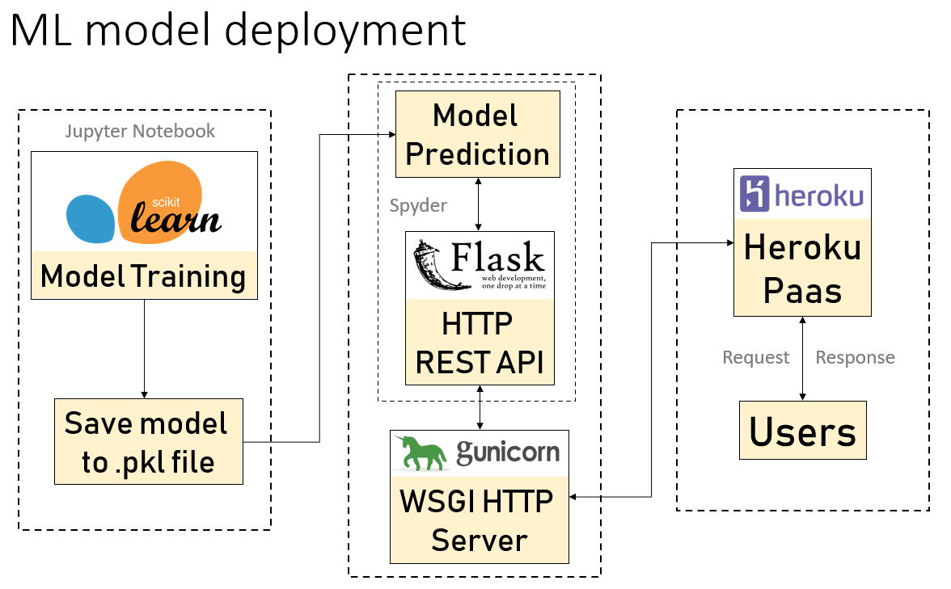

Slide 15
CONCLUSION
The Predictive Modelling and Analysis of Airfare Trends & Ticket Pricing project provided valuable insights into how machine learning can be applied to forecast airfare fluctuations and understand pricing strategies. By leveraging historical flight data, various factors influencing ticket prices, such as booking time, seasonality, airline, and route, were analyzed and modeled.
Key findings from this analysis include:
Price Predictability: The analysis revealed that airfare prices fluctuate significantly depending on the time of booking. Predictive models, especially those based on time-series forecasting, demonstrated the ability to estimate future ticket prices with reasonable accuracy, offering travelers and travel businesses opportunities for cost optimization.
Feature Importance: Factors such as flight distance, demand during peak seasons, airline competition, and booking lead time were found to be key determinants of ticket pricing. These insights help airlines and consumers understand the rationale behind pricing strategies.
Model Performance: Among the models employed Random Forest regressor Linear Regression, Decision tree Regressor demonstrated the best performance in predicting future airfare prices, with a balanced trade-off between accuracy and computational efficiency.
Business Impact: By identifying patterns in airfare pricing, the model can assist airlines in dynamic pricing strategies, maximizing revenue during peak demand and filling flights during low-demand periods. Travelers, on the other hand, can benefit from price forecasts by booking tickets during optimal periods for better savings.
Challenges and Limitations: Although predictive models offer valuable insights, challenges like sudden external events (e.g., fuel price hikes, natural disasters, or pandemics) may impact pricing, making predictions less reliable during such unforeseen situations.
THANK YOU
Four your Attention and Support

